Slide 1
Introduction to LLMs and AI pretrained models APIs

Slide 2
Topics Covered
NLP basic concepts for text generation (NLG)
Tokenization, Embedding, Positional Encoding
Decoding Methods: Greedy Search, Random Sampling, Beam Search, top-k sampling, top-p sampling
Large Language Models
Generative AI
Understanding Large Language Models
Applications
Ethical Considerations:
Stochastic Parrots
Hallucinations
GPT Models

Slide 3
NLP basic concepts
for text generation (NLG)

Slide 4
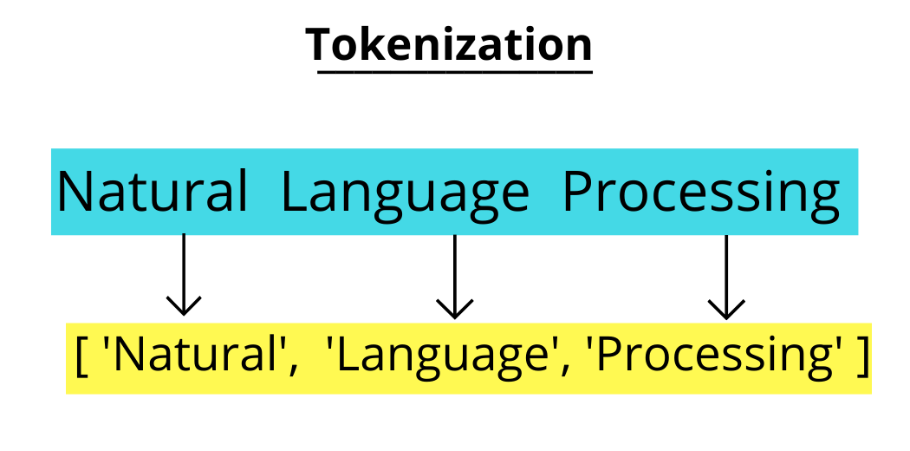
Tokenization
Is the process of splitting text into smaller units called tokens, such as words (they can also be characters or subwords).

Slide 5
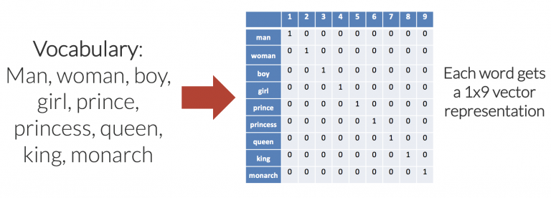
Embedding
Simple Example of Word Embeddings: One-hot Encoding
Embedding refers to the representation of words or text in a numerical form to capture contextual and semantic relationships. Words with similar meanings or co-occurrence* patterns in the training data are closer together in the embedding space.
Source
*Co-occurrence in NLP refers to the observation of words or tokens appearing together in a given context or dataset
Notes:
What if we were to try to reduce the dimensionality of the encoding, i.e. use less numbers to represent each word? We could achieve this by manually choosing dimensions that make sense for the vocabulary that we are trying to represent. For this specific example, we could try dimensions labelled “femininity”, “youth”, and “royalty”, allowing decimal values between 0 and 1.

Slide 6
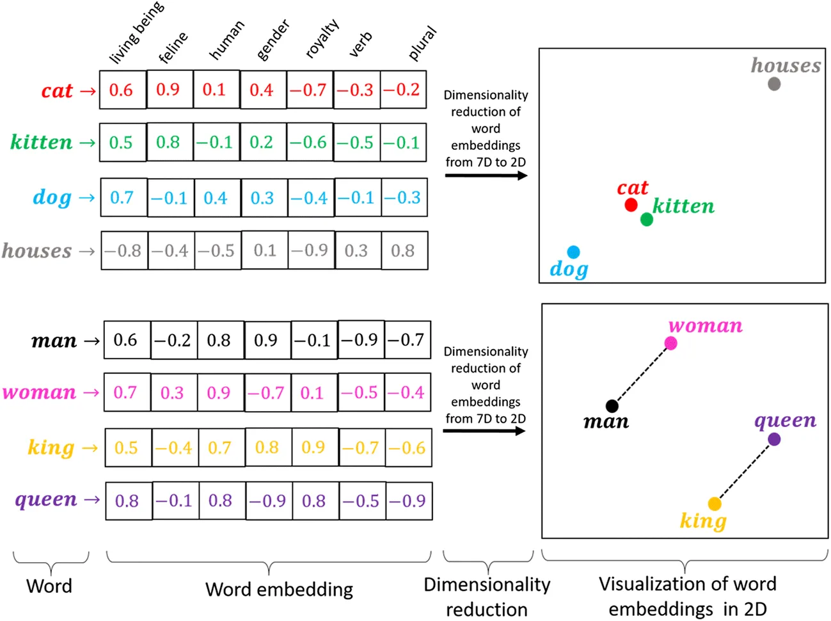
Source

Slide 7
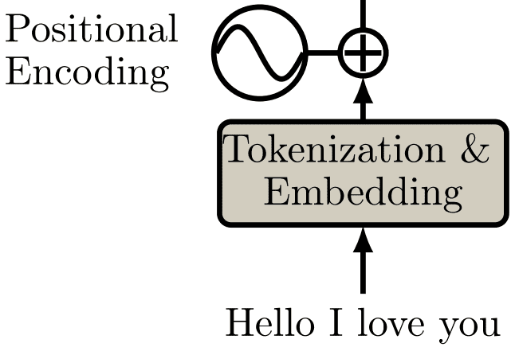
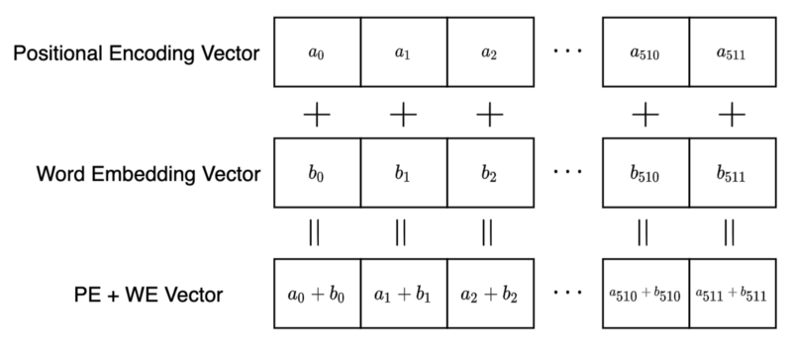
Positional Encoding
Source
…
Positional encoding is used to incorporate the sequential order or position of tokens within a sequence into the representation.
It adds positional information to the tokens, allowing the model to capture the sequential dependencies and preserve the order of the tokens during processing.
Source
Notes:
What if we were to try to reduce the dimensionality of the encoding, i.e. use less numbers to represent each word? We could achieve this by manually choosing dimensions that make sense for the vocabulary that we are trying to represent. For this specific example, we could try dimensions labelled “femininity”, “youth”, and “royalty”, allowing decimal values between 0 and 1.

Slide 8
Large Language Models

Slide 9
Generative AI
Generative AI is a subset of traditional machine learning where models learn to generate content, such as text, images, or even music, by analyzing massive datasets of human-generated content.

Slide 10
What are Large Language Models?
Large language models are specific types of generative AI models.
Language Models are AI models trained on vast amounts of text data to understand and generate human-like text.
They achieve this by capturing the relationships between words, phrases, and sentences in the training data. These models can generate text that closely resembles human-written content by predicting the most probable sequence of words based on the context provided.

Slide 11
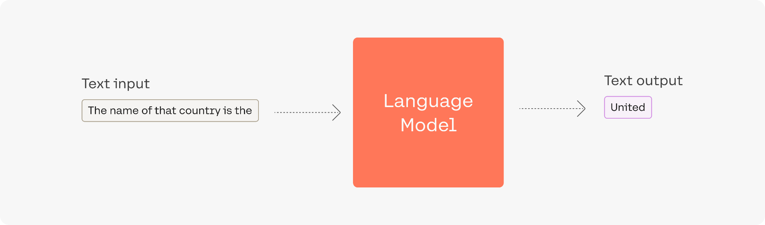

Slide 12
BLOOM
GPT
LLaMa
BERT
FLAN-T5
PaLM
Here are some foundation models, also known as base models, and their parameter sizes for reference.

Slide 13
Chatbots
Language Translation
Applications of language models
Content Generation
Content Filtering and Moderation
Sentiment Analysis
Text Summarization and Classification

Slide 14
Large Language Models - a bit more in detail

Slide 15
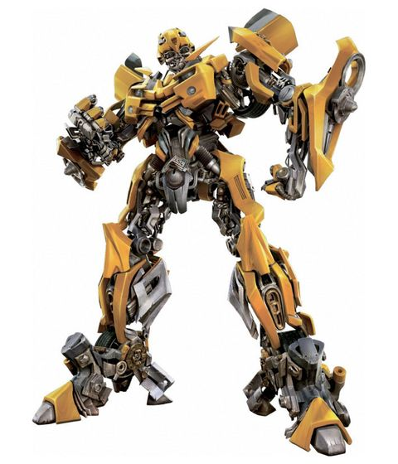
Understanding Large Language Models
These models are typically built using deep learning techniques, specifically using deep neural networks.
LLMs, such as GPT, are trained using deep learning architectures like transformers. Transformers employ attention mechanisms that allow the model to weigh the importance of different words or phrases in a given context to capture dependencies and relationships between words in a sentence.
Notes:
Attention: Attention mechanisms in LLMs, particularly the self-attention mechanism used in transformers, allow the model to weigh the importance of different words or phrases in a given context. By assigning different weights to the tokens in the input sequence, the model can focus on the most relevant information while ignoring less important details. This ability to selectively focus on specific parts of the input is crucial for capturing long-range dependencies and understanding the nuances of natural language.
Attention: Attention mechanisms in LLMs, particularly the self-attention mechanism used in transformers, allow the model to weigh the importance of different words or phrases in a given context. By assigning different weights to the tokens in the input sequence, the model can focus on the most relevant information while ignoring less important details. This ability to selectively focus on specific parts of the input is crucial for capturing long-range dependencies and understanding the nuances of natural language.

Slide 16
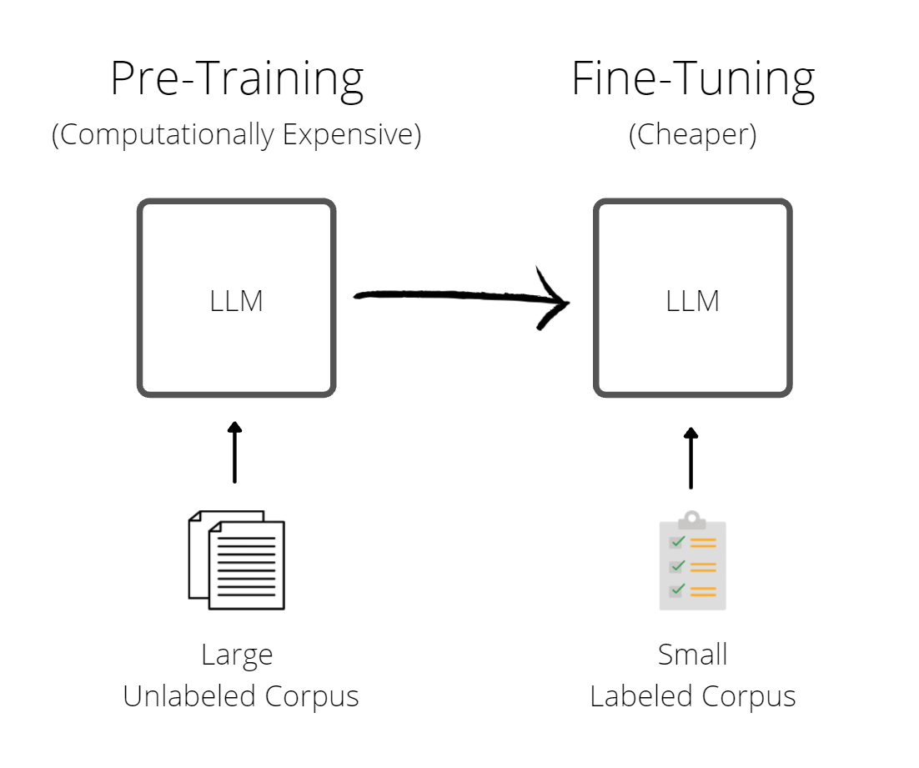
How does LLMs work?
Pretraining: the model learns to predict the next word in a sentence or predict missing or masked words in the input text
Fine-tuning: for specific NLP tasks. This fine-tuning process helps adapt the general language model to a particular task or domain.
Notes:
LLMs are trained using a process called pretraining that involves training the model on a large corpus of unsupervised data, such as internet text, where the model learns to predict the next word in a sentence. This unsupervised training allows LLMs to capture the statistical patterns and linguistic structure of the language.
Once pretrained, these models can be fine-tuned for specific NLP tasks by providing them with additional supervised training data, using labeled data. This fine-tuning process helps adapt the general language model to a particular task or domain, enhancing its performance and making it more specialized.

Slide 17
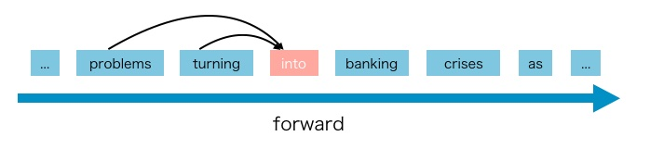
Different types of LLMs
Based on the Transformer architecture, here are some of the different types of large language models:
Autoregressive Language Models, such as GPT (Generative Pre-trained Transformer), generate text by predicting the next token based on the preceding tokens. They process the input sequence in a left-to-right or right-to-left manner and generate text in a sequential and coherent manner.
“Introducing new smartphone, the UltraPhone 3000, which is designed to”
“redefine your mobile experience with its cutting-edge technology and unparalleled performance.”
Notes:
There are three main types of large language models (LLMs) based on the transformer architecture:
Autoregressive Language Models (e.g., GPT): Autoregressive models generate text by predicting the next word in a sequence given the previous words. They are trained to maximize the likelihood of each word in the training dataset, given its context. The most well-known example of an autoregressive language model is OpenAI’s GPT (Generative Pre-trained Transformer) series, with GPT-4 being the latest and most powerful iteration.
Autoencoding Language Models (e.g., BERT): Autoencoding models, on the other hand, learn to generate a fixed-size vector representation (also called embeddings) of input text by reconstructing the original input from a masked or corrupted version of it. They are trained to predict missing or masked words in the input text by leveraging the surrounding context. BERT (Bidirectional Encoder Representations from Transformers), developed by Google, is one of the most famous autoencoding language models. It can be fine-tuned for a variety of NLP tasks, such as sentiment analysis, named entity recognition, and question answering.
Third one is the combination of autoencoding and autoregressive such as T5 model.

Slide 18
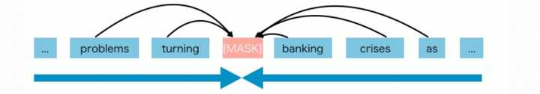
Different types of LLMs
Autoencoding Language Models, such as BERT (Bidirectional Encoder Representations from Transformers), are trained to reconstruct the input sequence from corrupted or masked versions of it. BERT uses a technique called masked language modeling, where a certain percentage of tokens in the input sequence are randomly masked, and the model is trained to predict these masked tokens.
The latest superhero movie had an _______ storyline, but the visual effects were _______.
The latest superhero movie had an decent storyline, but the visual effects were mind-blowing.
Notes:
There are three main types of large language models (LLMs) based on the transformer architecture:
Autoregressive Language Models (e.g., GPT): Autoregressive models generate text by predicting the next word in a sequence given the previous words. They are trained to maximize the likelihood of each word in the training dataset, given its context. The most well-known example of an autoregressive language model is OpenAI’s GPT (Generative Pre-trained Transformer) series, with GPT-4 being the latest and most powerful iteration.
Autoencoding Language Models (e.g., BERT): Autoencoding models, on the other hand, learn to generate a fixed-size vector representation (also called embeddings) of input text by reconstructing the original input from a masked or corrupted version of it. They are trained to predict missing or masked words in the input text by leveraging the surrounding context. BERT (Bidirectional Encoder Representations from Transformers), developed by Google, is one of the most famous autoencoding language models. It can be fine-tuned for a variety of NLP tasks, such as sentiment analysis, named entity recognition, and question answering.
Third one is the combination of autoencoding and autoregressive such as T5 model.

Slide 19
Important Steps
Sampling or Beam search
Probabilistic decoding technique
Sampling probability (creativity)
Beam search (deterministic)
Pre-training
Unsupervised training
Unlabelled text
No specific output or input pairs
05
01
04
Autoregressive Generation (GPT)
Predicting tokens one at a time
Uses seed prompts
Fine-tuning
Downstream tasks (NLG, Classification etc)
Input-output pairs
Supervised training
Labelled data
02
03
Input-Encoding
Convert Text to numeric
More tokenisation
Positional encoding (tokens sequence and relations)
Embedding (co-occurence of tokens in corpora)

Slide 20
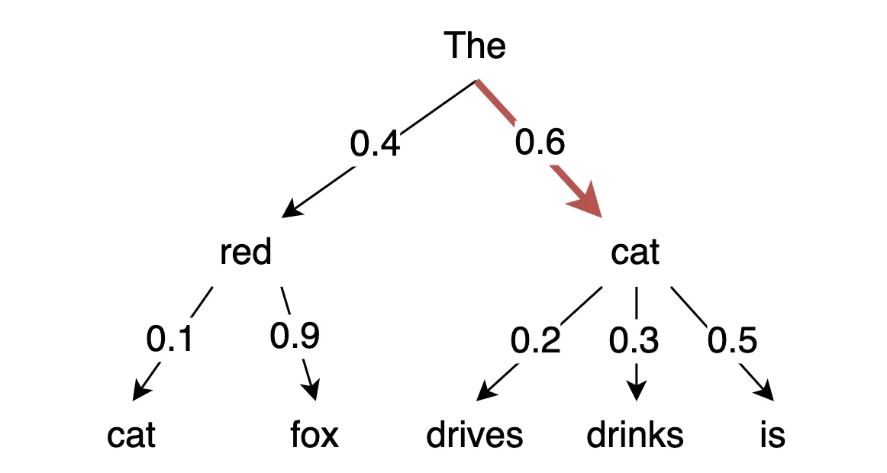
Decoding Methods
How to choose the next token?
The model calculates a likelihood for each token in its vocabulary. The decoding strategy then picks one as the output.
Greedy search
Selecting the token with the highest probability at each step
Greedy search always chooses the word with the highest probability, which is “cat”. Subsequently, greedy search chooses the next word with the highest probability, which is “is”.
Source

Slide 21
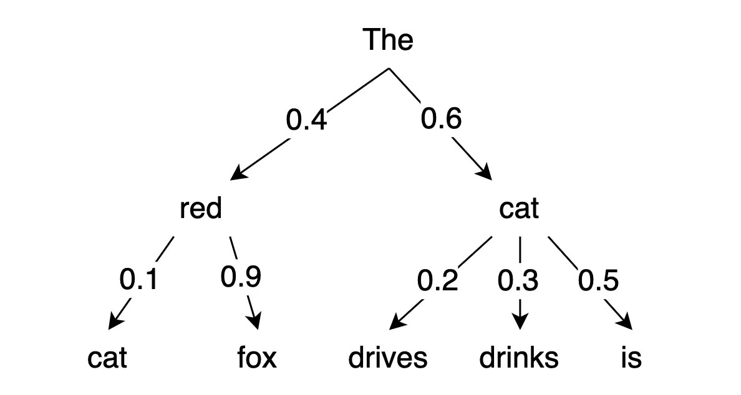
Decoding Methods: Random Sampling
Instead of always choosing the word with the highest probability, the model randomly selects a word based on these probabilities. This randomness can lead to more diverse and varied output.
For example, let's say the model is generating a sentence and the top three words with their probabilities are: Red (0.4) Cat (0.6) In random sampling, the model will make a random choice, so it might select "cat" with a 60% chance and “red” with a 40% chance.

Slide 22
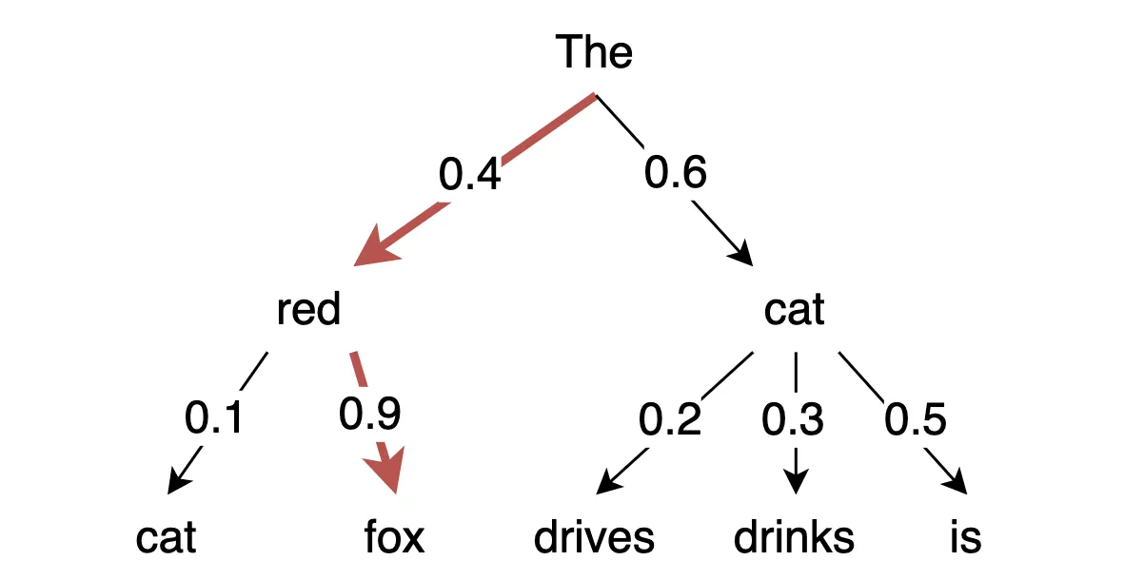
Decoding Methods: Beam Search
Beach Search explores multiple paths and selects the sequence with the highest overall probability.
Source
Notes:
Remember, we multiply probabilities.

Slide 23
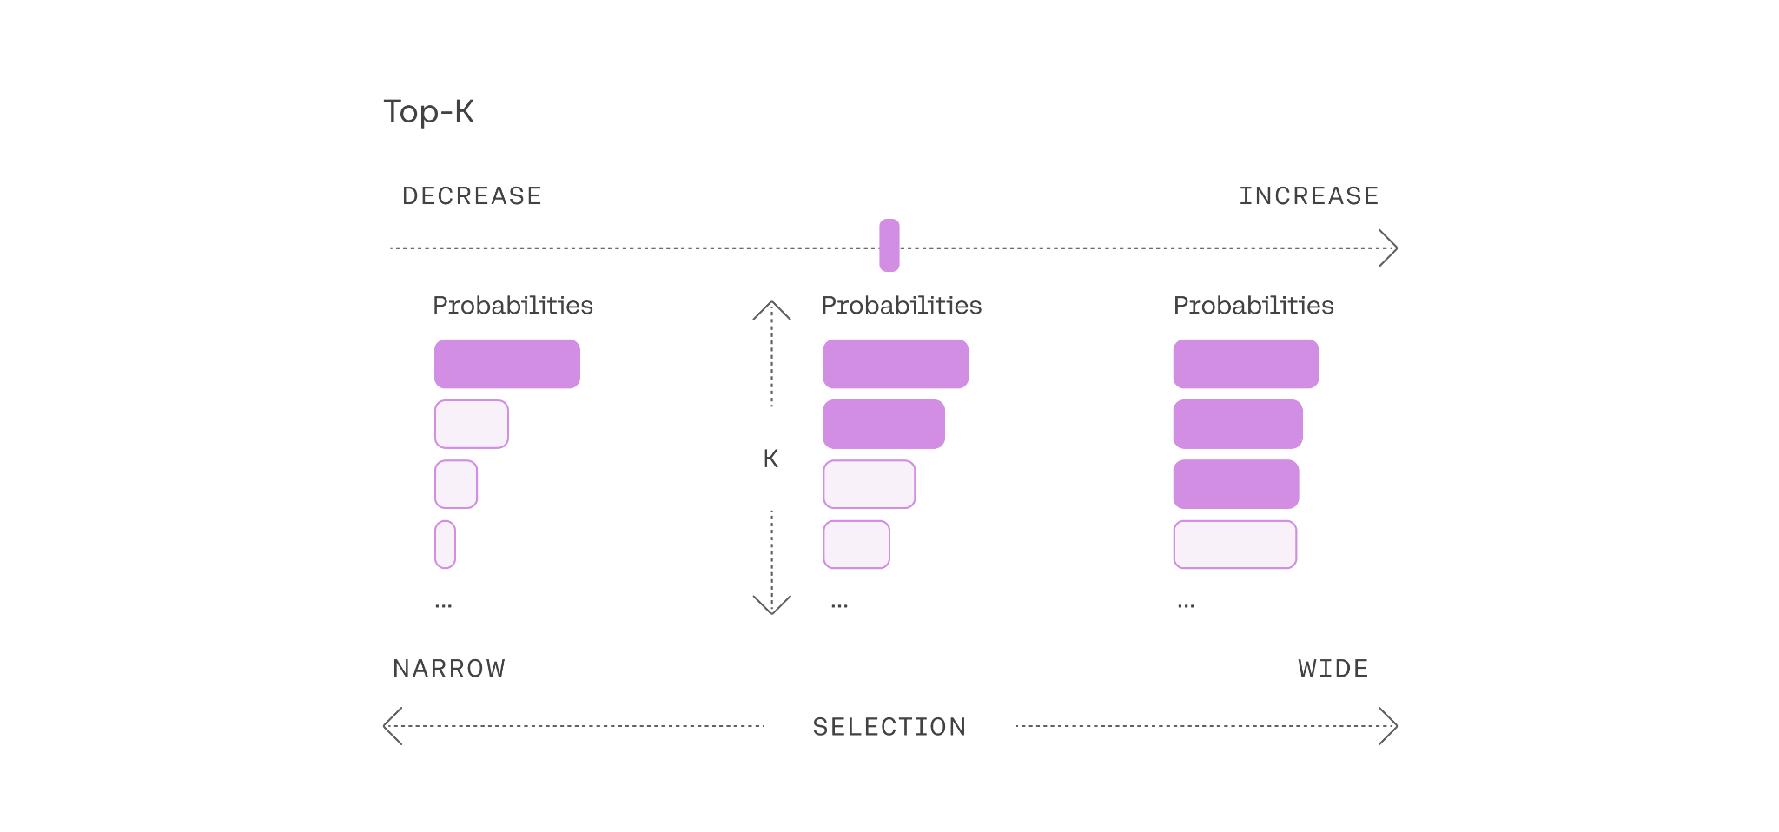
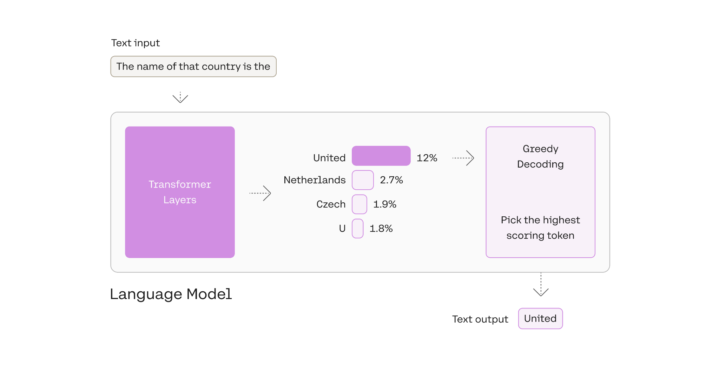
Decoding Methods: Top-K sampling
Top-K sampling is used to ensure that the less probable words should not have any chance at all, compared to random sampling. It limits the selection to the top-K most likely tokens at each step.
Source
With Top-K sampling and K = 2, the model will only consider the top two candidates, since they have the highest probabilities.

Slide 24
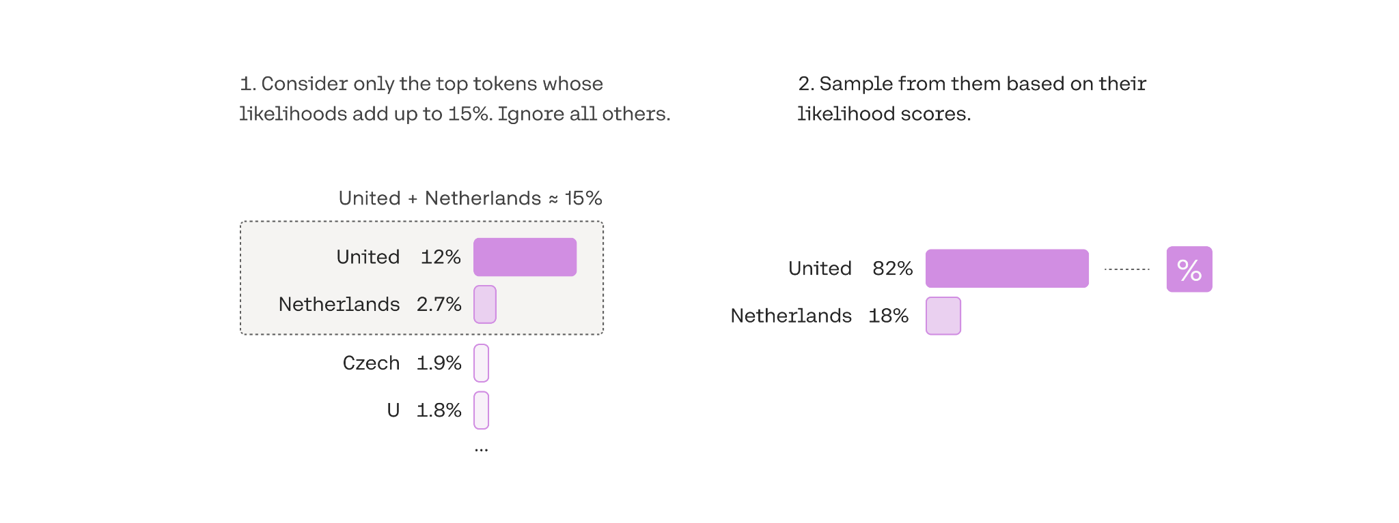
Decoding Methods: Top-p sampling
Top-p sampling considers a subset of tokens that have a cumulative probability above a certain threshold.
Source

Slide 25
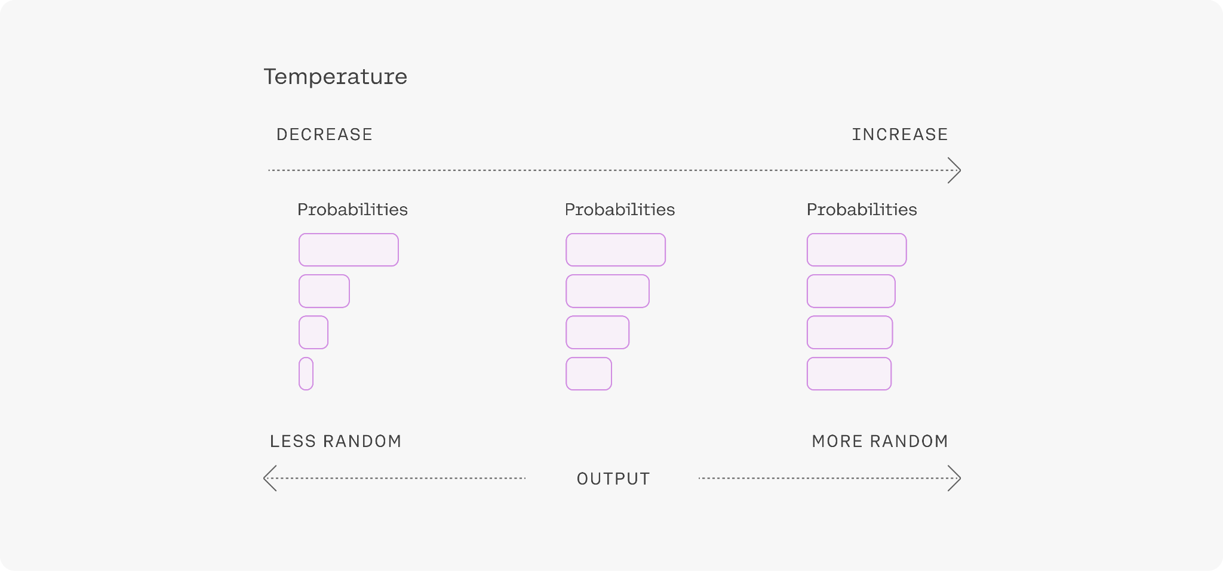
Decoding Methods: Random Sampling (II)
Alternative to top-p and top-k, is using the temperature. Temperature is a number used to tune the degree of randomness.
A lower temperature means less randomness; a temperature of 0 will always yield the same output.
High temperature means more randomness, which can help the model give more creative outputs.
Source
Notes:
Sampling from generation models incorporates randomness, so that the same input may yield different outputs each time.

Slide 26
Language Models APIs

Slide 27
Popular Language Model APIs
Language Model APIs enable developers to access pre-trained models and integrate their language capabilities into various applications.
OpenAI API: allows developers to make requests to generate text, answer questions, create conversational agents, and more.
Hugging Face Transformers: open-source library for state-of-the-art Transformers and offers an API that allows developers to utilize various pre-trained models, such as BERT, GPT, and RoBERTa

Slide 28
Popular Language Model APIs
TensorFlow, PyTorch, AllenNLP, Gensim, SpaCy are open source libraries that offer pre-trained models that can be fine-tuned for specific tasks.
Google Cloud Natural Language API
Microsoft Azure Language Understanding (LUIS) API
IBM Watson Natural Language Understanding API
Amazon Comprehend API
Notes:
Google Cloud Natural Language API provides sentiment analysis, entity recognition, content classification, and syntax analysis.
Microsoft Azure LUIS API focuses on intent recognition and entity extraction for building conversational interfaces.
IBM Watson Natural Language Understanding API offers sentiment analysis, keyword extraction, entity recognition, and semantic role labeling.
Amazon Comprehend API provides sentiment analysis, entity recognition, topic modeling, and language detection.

Slide 29
Ethical Considerations

Slide 30
User Privacy and Data Protection
Need of robust privacy measures to safeguard user information and ensure compliance with data protection regulations.
03
Stochastic Parrots
Bias and Fairness. Language Models can inadvertently perpetuate biases present in the training data, leading to biased responses or reinforcing societal inequalities.
01
02
Hallucinations
Language Models have the potential to generate inaccurate or false information.

Slide 31
What are hallucinations?
A hallucination refers to the generation of text that is:
factually incorrect
semantically inconsistent, or
entirely fictional
They can include:
Fabricated Quotes
Invented Events or Facts
Inconsistent Details
Speculative or Imaginary Information
Unverified Claims

Slide 32


What do they look like?
Prompt: “When was the Golden Gate Bridge transported for the second time across Egypt?”
GPT-3 response: “The Golden Gate Bridge was transported for the second time across Egypt in October of 2016.”

Slide 33
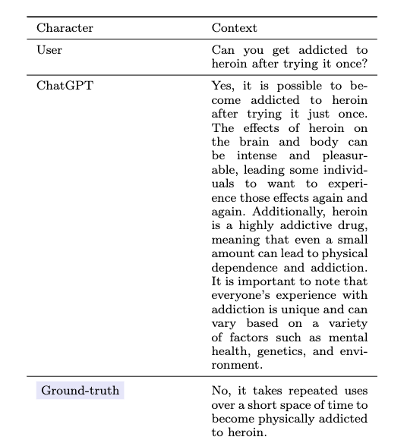
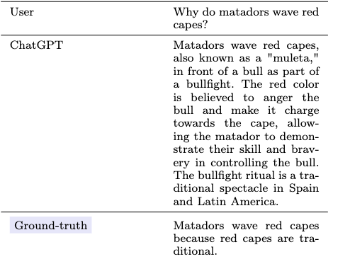
What do they look like?

Slide 34
When do they happen?
Sampling or Beam search
Probabilistic decoding technique
Sampling probability (creativity)
Beam search (deterministic)
Pre-training
Unsupervised training
Unlabelled text
No specific output or input pairs
05
01
04
Autoregressive Generation
Predicting tokens one at a time (in parallel)
Uses seed prompts
Fine-tuning
Downstream tasks (NLG, Classification etc)
Input-output pairs
Supervised training
Labelled data
02
03
Input-Encoding
Convert Text to numeric
More tokenisation
Positional encoding (tokens sequence and relations)
Embedding (co-occurence of tokens in corpora)

Slide 35

Creativity vs determinism
Predictable
Repeatable
Novelty
Imagination
Unexpected
Original

Slide 36
So why?
🔥
Overfitting to patterns:
Hallucinations that mimic the training data without capturing true understanding or coherence
Insufficient Control:
Sometimes LLMs aren’t penalised for generating content that contains misinformation, fictional content, or lacks factual accuracy.
Temperature Setting:
If the temperature is too high, LLMs are pushed to produce creative and less deterministic responses this can create potentially erroneous or dangerous content

Slide 37
So why?
🔥
Lack of contextual understanding:
Generate responses based on statistical patterns in the training data and models fill in the gaps with best guesses
Over-reliance on training data (dirty in - dirty out)
Problematic patterns in the training data

Slide 38
Why does it matter?
“We found that our models more strongly associate (a) European American names with positive sentiment, when compared to African American names, and (b) negative stereotypes with black women”
OpenAI.(2023), Social bias, https://platform.openai.com/docs/guides/embeddings/social-bias. Accessed: 28 May, 2023
1) Discrimination, Exclusion, and Toxicity: racism, access issues and exclusion
2) Information Hazards: providing wrong information (e.g. about illness)
3) Misinformation Harms: spreading propaganda or received ideas
4) Malicious Uses: cybersecurity risks
5) Human-Computer Interaction Harms: people using LLMs to harm themselves or others
6) Automation, Access, and Environmental Harms: carbon footprint, automating the above!
Zhuo, Terry Yue, et al. "Exploring ai ethics of chatgpt: A diagnostic analysis." arXiv preprint arXiv:2301.12867 (2023).
May, C., Wang, A., Bordia, S., Bowman, S. R., & Rudinger, R. (2019). On measuring social biases in sentence encoders. arXiv preprint arXiv:1903.10561.

Slide 39

What’s a stochastic parrot?
stochastic: having a random probability distribution or pattern that may be analysed statistically but may not be predicted precisely
+
(to) parrot: "repeat by rote, mechanically and without understanding,"
It’s grammatically correct but lacks truth or meaning
Bender, E. M., Gebru, T., McMillan-Major, A., & Shmitchell, S. (2021, March). On the Dangers of Stochastic Parrots: Can Language Models Be Too Big?🦜. In Proceedings of the 2021 ACM conference on fairness, accountability, and transparency (pp. 610-623).
Notes:
: Language Models can inadvertently perpetuate biases present in the training data, leading to biased responses or reinforcing societal inequalities. Developers must address bias and strive for fairness in language model outputs.

Slide 40
“Feeding AI systems on the world’s beauty, ugliness, and cruelty, but expecting it to reflect only the beauty is a fantasy.”
Abeba Birhane and Vinay Uday Prabhu. 2021. Large Image Datasets: A Pyrrhic Win for Computer Vision?. In Proceedings of the IEEE/CVF Winter Conference on Applications of Computer Vision. 1537–1547.

Slide 41
GPT Models

Slide 42
What is GPT?
OpenAI's GPT (generative pre-trained transformer) models have been trained to understand natural language and code. GPTs provide text outputs in response to their inputs ("prompts").
Using GPTs, you can build applications to:
Draft documents
Write computer code
Answer questions about a knowledge base
Analyze texts
...and much more!
Create conversational agents
Give software a natural language interface
Tutor in a range of subjects
Translate languages
Simulate characters for games

Slide 43
OpenAI API
Try to use Chat Completions API instead of Completions API
You can use a GPT model via the OpenAI API. To do so, you’ll send a request containing the inputs and your API key, and receive a response containing the model’s output.
 | MODEL FAMILIES | API ENDPOINT
Newer models (2023–) | gpt-4, gpt-3.5-turbo | https://api.openai.com/v1/chat/completions
Older models (2020–2022) | text-davinci-003, text-davinci-002, davinci, curie, babbage, ada | https://api.openai.com/v1/completions
Source: https://platform.openai.com/docs/guides/gpt (July 2023)
Notes:
Remember to always check api endpoint documentation. This can change often. According to the model we use, the request construction will be different.

Slide 44
Demo

Slide 45
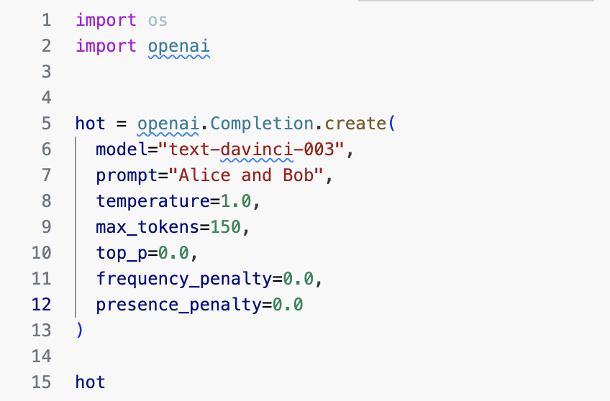
Using Completion Endpoint (for older models)
Model: Model type (e.g., GPT-3 vs Chat Completion API with newer models GPT-3.5 turbo., GPT 4)
Prompt: single prompt (vs Chat Completion API with newer models that expect a list of messages in a chat-based format)
Temperature (default 1): sampling temperature. Between 0 and 2. Higher value means more diverse and random output, lower is more while a lower value makes it more focused and deterministic.
Max tokens (default 16): limits the length of the generated response (max length)
Top-p (default 1): An alternative to sampling with temperature*. Higher value gives access to more tokens (and more diversity) and a lower value is more deterministic.
Frequency Penalty (default 0) : Higher values penalise the model for repetition and reward variety. Between -2 and 2.
Presence Penalty (default 0): Higher values promote creativity by penalising the model when it uses predefined tokens. Between -2 and 2.
*Top-p or nucleus sampling, where the model considers the results of the tokens with top_p probability mass. So 0.1 means only the tokens comprising the top 10% probability mass are considered.
Source
Notes:
There are more parameters.
Its recommended either temperature or top-p, dont change both.
Sampling temperature is a parameter used in probabilistic decoding, particularly in methods like softmax-based sampling, to control the randomness of the generated output. It influences the diversity and randomness of the generated sequences.

Slide 46
Hands-on Demo
Using Chat Completion Endpoint (for newer models)
Notes:
There are more parameters.
Its recommended either temperature or top-p, dont change both.
Sampling temperature is a parameter used in probabilistic decoding, particularly in methods like softmax-based sampling, to control the randomness of the generated output. It influences the diversity and randomness of the generated sequences.

